Slide 1
Insight Series
Virtual Presentations
The mission of the LASE Insight Series is to provide educators with high quality professional development to increase their tool box of skills and strategies for meeting the unique needs of struggling learners.

Slide 2
SQUARE 1:
Grace for Re-entering School during Covid19

Slide 3
Looking at Social Emotional Needs

Slide 4
What we know:
Remote teaching/learning was stressful
Loss of control was stressful
Being isolated from friends was stressful
Unpredictability of current situation is stressful

Slide 5
Therefore…
Even our most successful students probably didn’t master and retain what we would normally expect them to.
A new sense of normal needs to be developed
We need to find ways to be comfortable together in this new situation

Slide 6
What can we do?
Build community
Process the past
Give sense of control through choices
Teach emotional awareness and regulation

Slide 7
Processing the Past: Intentionally spend time sharing feelings and experiences with students.
Pros and cons list
Class discussion
Two things
Alphabet game

Slide 8
Choices: Intentionally build opportunities to choose into the student’s daily experiences.
More than one way to demonstrate “I get it”, choices in how an assignment is completed
“New Normal” is rigid, where can we be flexible? If not seating or group work, perhaps how time is spent, when to take a break, how to take a break, formats for notes

Slide 9
Emotional awareness and regulation: Intentionally work with students on identifying feelings and strategies to work through them.
Name emotion (faces poster?) It looks like you are feeling…
Teach calming strategies (my 3 favorite)
Strategize what to do next
time this feeling is coming

Slide 10
Looking at Executive Function NEEDs

Slide 11
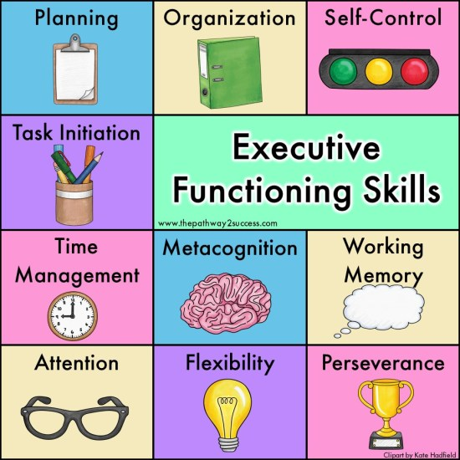
Children and adults with executive functioning problems struggle to organize materials and set schedules. They misplace papers, reports, and other school materials.
Notes:
The frontal lobes can be thought of as the conductor of the brain's orchestra.

Slide 12
What we know:
EXPECT stunted levels of initiation, organization, task completion, engagement, attention because what was done at home was most likely done differently and less independently and didn’t necessarily build on previous skill level or look like what was done at school
Return to school structure will not be like “riding a bike”
Dealing with a new situation (new grade, online learning) doesn’t mean students will gain new skills needed to be successful automatically
Students that had weak EF skills will return with them being even weaker
Ability to initiate and sustain attention will be weakened because it’s been 6 months since students had the demands of a full day of school
Just like an athlete practices a skill our students
didn’t get to practice their EF skills so they will be rusty
Notes:
(just like an athlete practices a skill our students didn’t get to practice their EF skills

Slide 13
Therefore:
Remove should from vocabulary: they should, I shouldn’t…..
Know that all students, but especially those with EF weaknesses, are going to need extra support for a longer period of time
Intentionally provide scaffolding, structure and routine
Pre-teach, re-teach, teach, teach again, review and review again

Slide 14
What can we do?
Be intentional, systematic, explicit, structured, routined and unified in every expectation and skill
Support, encourage, model, reward sustained attention and task initiation
Make it visual (calendars, schedules, notebooks…)online or in person
Build in times and opportunities for movement (be intentional!)
Utilize student engagement strategies
Make your thinking visible by verbalizing it, speak in
positives and use language that is going to help students
think through the process, routine
Give LOTS of grace to your students and yourself

Slide 15
Be intentional, systematic, explicit, structured, routined and unified in every expectation and skill
Expect and accept that any skill, routine or procedure you typically would teach in a week will take much longer to become automatic SO
make every routine visible and visual by posting lists on walls, desks, lockers and refer students to list
Color code everything-folders (reading is always red, science is always blue…)
Provide Visual references for what the end product should look like (writing assignment with margins, math paper, spelling test, science project….)
Notes:
Anything that becomes automatic gives kids brains more room to think about the topic or skill at hand. Always give that visual to refer back to because kids with weak EF typically have weak working memory

Slide 16
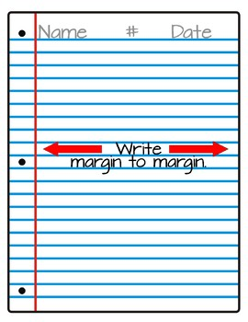
Unify expectations across grade levels (esp junior high)
It makes it easier for everyone!
And lessens the cognitive load making more room for students to think
Things like margins, headings, types of notebooks, binders, class rules, expectations
Routines for movement in the school-how to walk to the cafeteria, library, chapel, car line….
Could be done for grade level groups K-2, 3-5, 6-8, whole school, ….but especially in middle grades and junior high
Teach skills with intentionality and consistency until it
becomes automatic

Slide 17
Support, encourage, model, and reward sustained attention and task initiation
Visual timers on board, screen to show how much time student has to work, how long recess is… make time visible
Ask them to guess/estimate how much of the assignment they can complete in a given amount of time and then compare
Visual schedules (even for older students and tied to color notebook system)
Break tasks into smaller parts so student feels a sense of progress and accomplishment
(This strategy is good for individuals and whole classes; in person and online).
This is a powerful strategy for those students who just can’t seem to get started.
Often it’s because the task seems so huge that they feel overwhelmed. Breaking it
into smaller pieces helps them to start with a manageable chunk, provides a sense of
accomplishment when completed, which then encourages them to keep working

Slide 18
Build in times and opportunities for movement (be intentional!)
Especially challenging this year as there are restrictions on student interactions, seating, distancing requirements, teachers switching classrooms rather than students… which means we need to be all the more intentional
So it’s ok, for even middle schoolers to have a morning, lunch and afternoon recess!
Intentional movement in the classroom might look like:
Students standing for 3-5 minutes behind their desks to listen to the teacher talk. This can keep the brain oxygenated and primed for learning
Giving students permission to stand along the sides or in the back of the room or even the chance to sit on the tops of their desks.
Teaching outside
Notes:
Research shows repeatedly that movement is good for a learners brain

Slide 19
Make your thinking visible by verbalizing it, speaking in positives-spending more time telling your students what to do than what not to do and Using language that is going to help students think through the process, routine
Instead of saying: Try Saying:
Do… (this or that) What comes next? Have you checked the list? Tell me what you’re thinking.
Clean your desk or locker! Wow, this is messy! I bet it’s hard to find your math in there. What
do you think you should do about it? (And then, give them a
picture of how their desk or locker should look after cleaning it☺.)
Put your name in the left hand corner Put your name in the left hand corner Look at our model for a
Not the bottom , back, right and don’t reminder of HOW your paper should look put it……
put it….

Slide 20
Embed instruction that will allow for smooth transition to distance learning
Model the power of learning near natural light and bringing fresh air into the mix whenever possible, so that students carry this into their home learning spaces.
Teach all the APPS and use them in school from day 1: SeeSaw, Google meets, ZOOM
Determine a way to manage passwords so that students and parents can easily access them
Create routines that are consistent across all spaces—they are anchors for our day
Whether online or face-to-face, build a consistent routine for students
Here’s a morning routine for any environment:
Check announcements.
Complete morning check-in.
Open with devotion and prayer.
Open module (first lesson of the day) and begin first task.

Slide 21
Give LOTS of grace to your students and yourself: humor, patience, love

Slide 22
Looking at Academics
“What is teaching? Teaching is a chaotic mess of
joy and misery intertwined with moments of pride,
confusion, and love

Slide 23
Thoughts and Ideas for the Upcoming School Year
This year needs to start out differently than years past
Summer Slide Versus COVID slide
https://www.nwea.org/content/uploads/2020/04/NWEA_Press-Release_-Covid-slide-research_FINAL_4092020.pdf
Again, only 70% gains in reading and less than 50% gains in math.
Notes:
Individual classroom gaps
Think mid april in some instances, especially math

Slide 24
What Does That Mean for Us?
Relationships should be put first as the future is unpredictable
Focus on the most critical skills and knowledge at every subject and grade level
https://www.renaissance.com/focus-skills/
What if learning loss is not an issue?
Focus on more open ended/critical thinking problems within the focus skill versus moving onto another topic
Notes:
Critical versus important, but not critical
Ex. knowing letters and recognize lower and upper case versus knowing the order of the alphabet; how to use the pythagorean theorem to find a missing side of a right triangle versus knowing/explaining the proof behind it

Slide 25
Assess students more often; informal pre-assessments will be key!
Expect there to be gaps in student knowledge
Use the same pre-assessment at the end to gage student growth
Never grade pre-assessments
Use the prior grade level teacher as a resource if large gaps are noticed and brainstorm ways to bridge the gap
Entrance Slips; 4 Corners; Graffiti Wall;
Hardest First; Kahoot; KWL; etc.
Notes:
4 Corners - have students write their answer on paper first
Graffiti Wall: write as much as you can about vertebrates/invertebrates
Hardest First for use for gifted students or twice exeptional

Slide 26
Scaffolding
Add support when needed, then remove once mastered
Pre-teach vocabulary; display visual aids, and USE them; access prior knowledge; think aloud
Differentiating
Will be needed for more students than ever before
3 ways: change content; change process; change student product
Always end with the same objective
Tiered Assignments
Below-Level Task
On-Level Task
Above-Level Task

Slide 27
Universal Design for Learning
Offer/present information in more than 1 format
Text, audio, hands-on
More than 1 way to show what they know
Group projects*, oral presentations, paper/pencil
Engagement by giving choices
Find a way to use your online platform daily as being in the classroom everyday is not guaranteed.
We are all in this together; we must lean on each other for support.

Slide 28
For Parents
Simplify/streamline communication
Make involvement easy

Slide 29
Don’t forget yourself! Intentionally take time to take care of yourself.
Sleep
Eating
Time with God
Relationships with those who love you
How can you walk away when you need to?
Permission to say, “No thank you. Not at this time.”

Slide 30
For more information about LASE,
log onto www.lutheranspecialed.org or
email as info@lutheranspecialed.org

